Slide 1


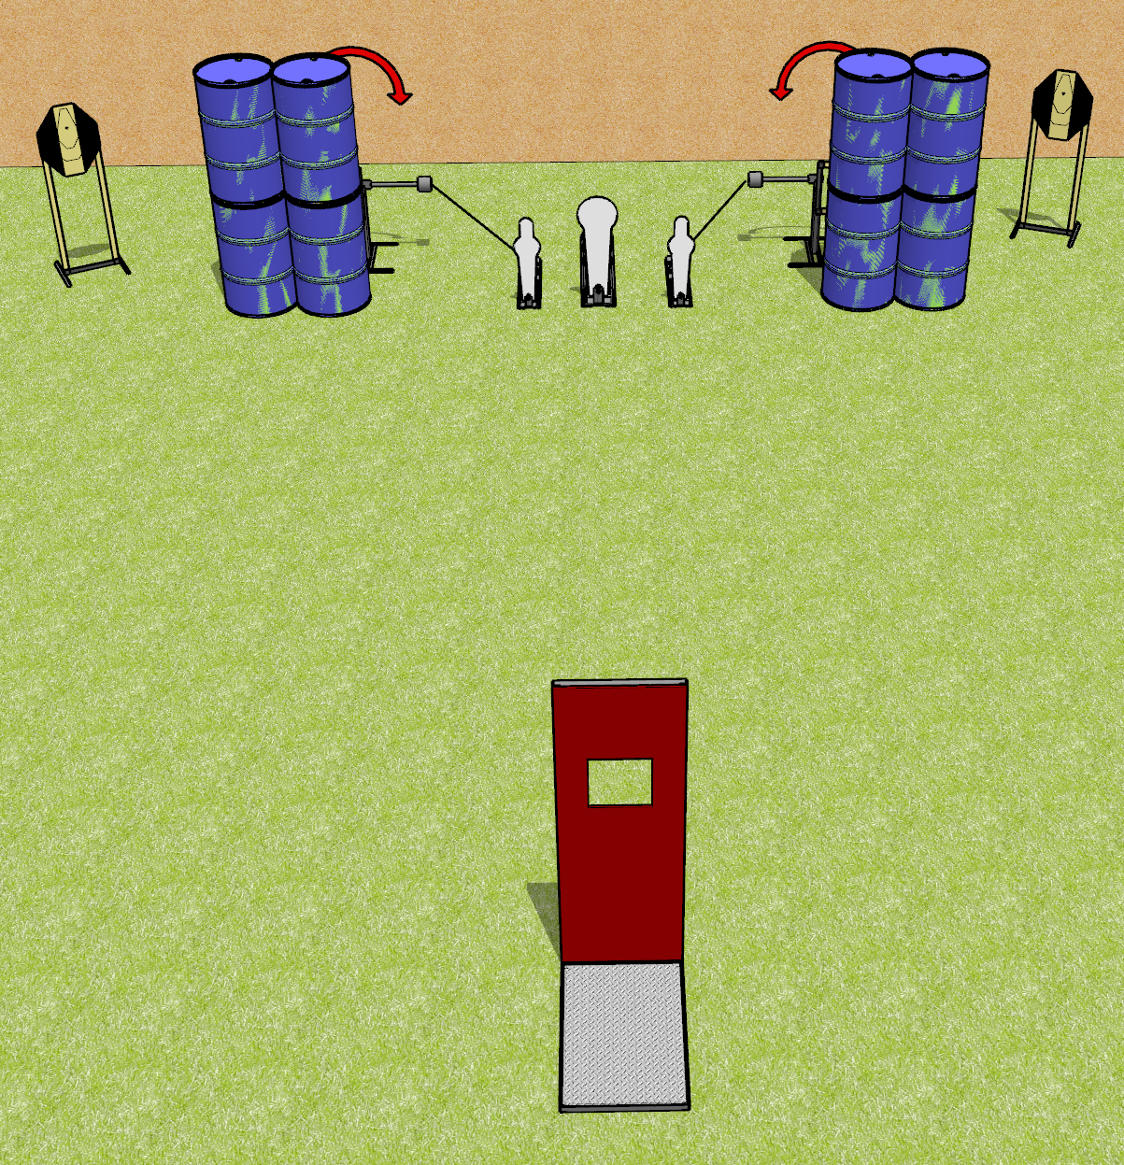
 | Dothan Gun Club – USPSA Match To the Sides Course Designer : Drew Coleman
Round Count 11 rounds 4 IPSC 2 MP, 1 colt popper
Equipment List 2 swingers + activators Barricade 2 tux

Slide 2
To the Sides
Written Stage Briefing
To the Sides is an 11 round, 55 point, Comstock course of fire. There are 4 IPSC targets and 3 steel. The best 2 hits on cardboard will score and steel must fall to score.
The swingers are activated by poppers and remain visible at rest.
Handgun start position is inside shooting area, hands touching upper marks. Handgun is loaded and holstered.
PCC start position is inside shooting area, muzzle touching either lower mark, stock on belt. Loaded carbine is held with both hands, safety on.
On the audible start signal, from within the shooting area, engage T1 and SW1, OR T2 and SW2, perform a mandatory reload, and engage the remaining array. Steel may be engaged at any time.

